Slide 1













DEPI-PROJECT-WEEK 1
1-Hagar Gamal
2-Farah Amr
3- Eman Mahomoud
Safaa Samy
Group leader
SQL part
python part
1- Safaa Samy
2- Basant Wael

Slide 2




















01
python notebook
Data describtion
05
creating python notebook for our data set
check quantiles
IQR
outliers
unique data
Our python notebook Workflow From Exploration to visualization
02
Importing libraries ,Dataset
Resolution
06
check columns name
renaming of some columns
adding column
count some data values
import pandas,matplotlip,
seaborn Dataset
03
Data Exploration
Testing and Verification
07
check Data shape ,Head ,tail and info
check cleaned dataset
04
Investigation
Data visualiziation
08
check Nulls dupplicates
missing values
creating some charts to visualize the data with a diffrent charts

Slide 3
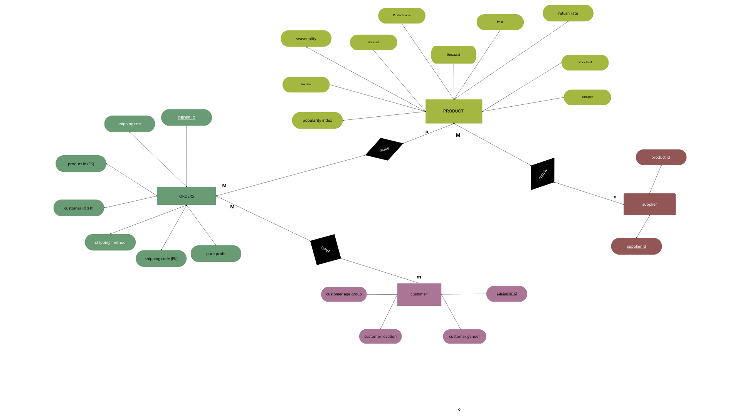
ERD Diagram

Slide 4
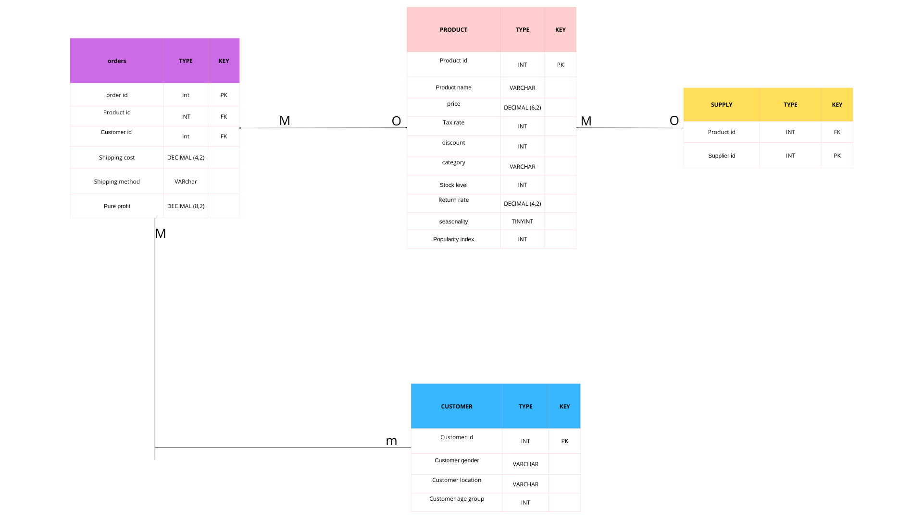
ERD tables

